Slide 1

Bringing terminal experience to the new level
Krzysztof Dąbrowski
Full Stack Developer

Slide 2

Agenda
About myself
Notes:
TODO: Finish agenda

Slide 3

Few words about myself
Who is this guy?
Full Stack specialist in Perlica
Applied Computer Science graduate
Programming enthusiast full of excitement
I dive as deep as I can into the topics of my interest
Love to learn and spread the knowledge
Dog lover

Slide 4

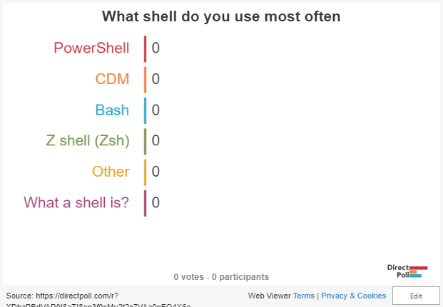
Your tool of choice
Let's get to know each other

Slide 5
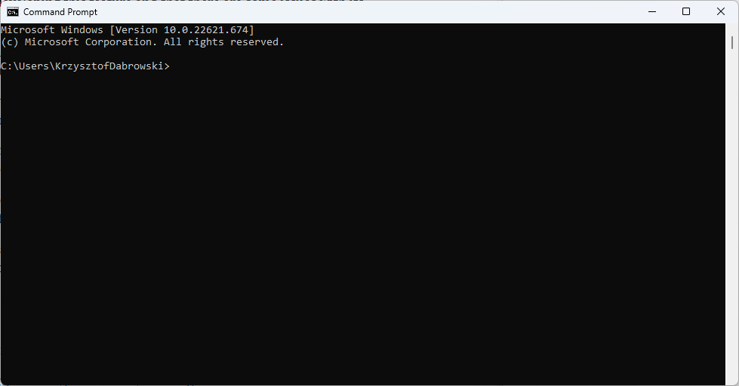
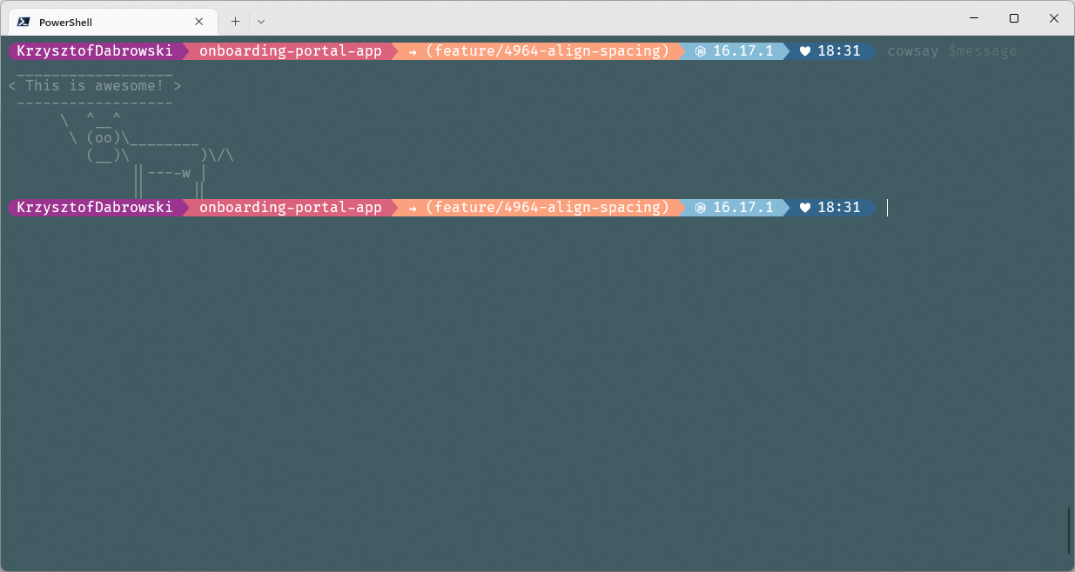
The journey
The journey of a thousand miles begins with one step
The beginning
After today :D

Slide 6
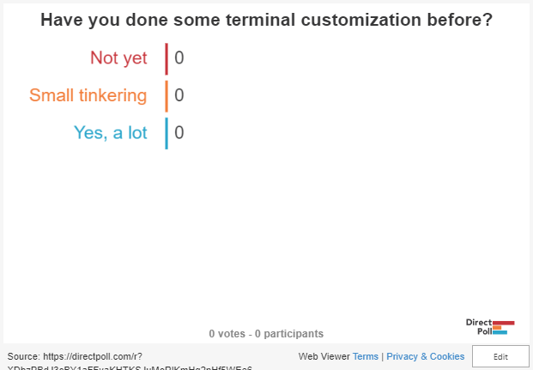
What’s your experience?
Have you done something like this before?

Slide 7
First improvement
Windows Terminal
Notes:
- Check how to set it as default in Windows 10
- Download link

Slide 8
Two types of PowerShell
Which to choose

Slide 9
Usefull shortcuts
Not even touching mouse
Notes:
Multiple pains
Coppy and paste
New tabs with diffrent profile
Duplicate tab
Duplicate pane
Change font size
Open command pallete
Settings

Slide 10
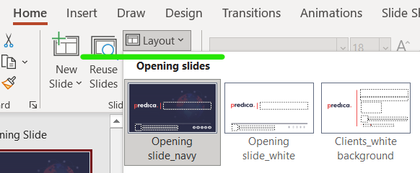
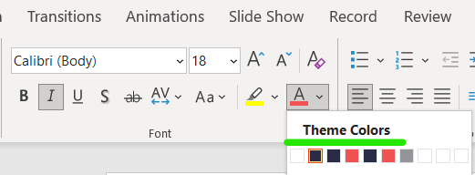
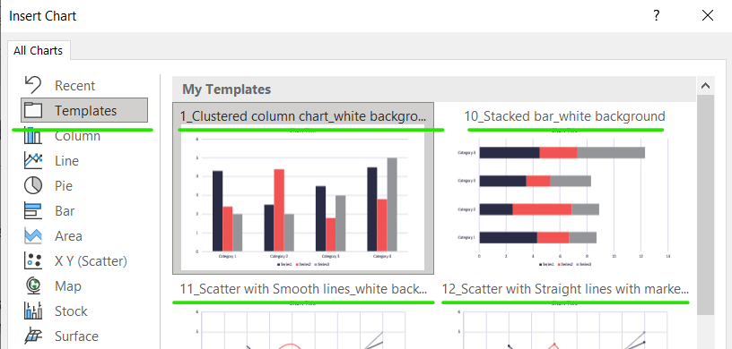
Guide for presentation design
Don’t edit this presentation! Download this layout to your computer, give the new title to the document and start creating your presentation.
For creating a new presentation use layouts. There are opening slides, agenda, navy and white content slides and Thank you page. Slides on the left column are examples of how you can illustrate your slides using layouts (slides 4-24).
The presentation can be either on white, or navy background. You can choose white or navy background according to your needs, for e.g. you can use a white background for charts, and navy for bright images.
Fonts, icons, charts, diagrams, etc., should be in brand colors (red, navy, white or grey). They are already grouped as “theme colors”. Please, don’t add any other color to presentation, except the colors on images and illustrations.
For creating the charts use templates instead of standard charts.

Slide 11
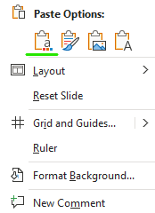
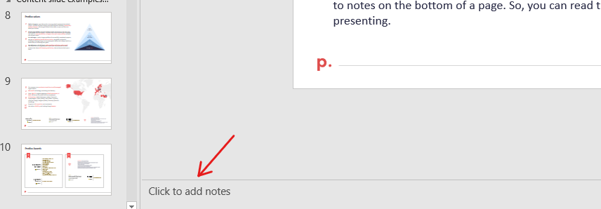
Guide for presentation design
If you copy the content from other source, be sure, that you choose “Use Destination Theme” option, so your materials suit to the presentation main theme.
In order to make your presentation more “readable” use icons, graphics and charts. Link to the icons can be found on slide 37 S/A. Pictures divided by industries are added on slides 38-62 S/A.
If you make the presentation for a client, use our clients’ logo (slide 4 S/A). That makes the presentation unique and tailored to each client. The logos of Predica’s key clients can be found on slides 25-36 S/A.
Don’t add to much text on a slide. Keep just the key statements and graphics there. The text that left can be added to notes on the bottom of a page. So, you can read them while presenting.

Slide 12
Thank you for attending!

